Slide 1
Interview Management System
By:-
Rahul Tuteja
(2017ucp1479)

Slide 2
Description
This system manages the recruiting and hiring process, including job postings and job applications. It organizes and makes searchable information about job seekers. It helps scheduling, issues notification alerts.
These systems maintain a database of new applicants and people who may be continuing prospects for future openings.
These systems maintain a database of new applicants and people who may be continuing prospects for future openings.

Slide 3
Technologies Used:-
Front-end :-Html,Css,Angular.js
Back-end:-Node.js
Database-MongoDb

Slide 4
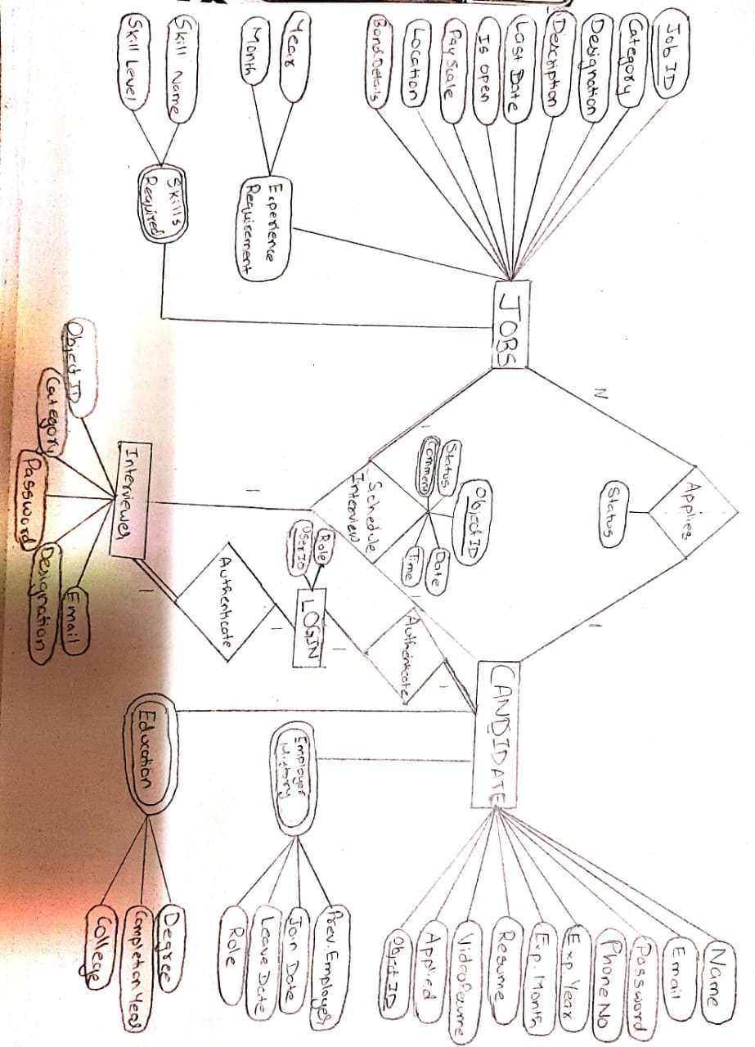
E.R. Diagram for the database

Slide 5
Different Users of the Website
Admin:
Add jobs
Add interviewers
Schedules Interview
Add different department of companies.
Decides to recruit the applicant or not.
Applicant:
Can browse the jobs for which he is eligible.
Can apply for the job.
Interviewer:
Can see the next interview scheduled for him.
Reply for the interview he has taken.

Slide 6
Login Page

Slide 7
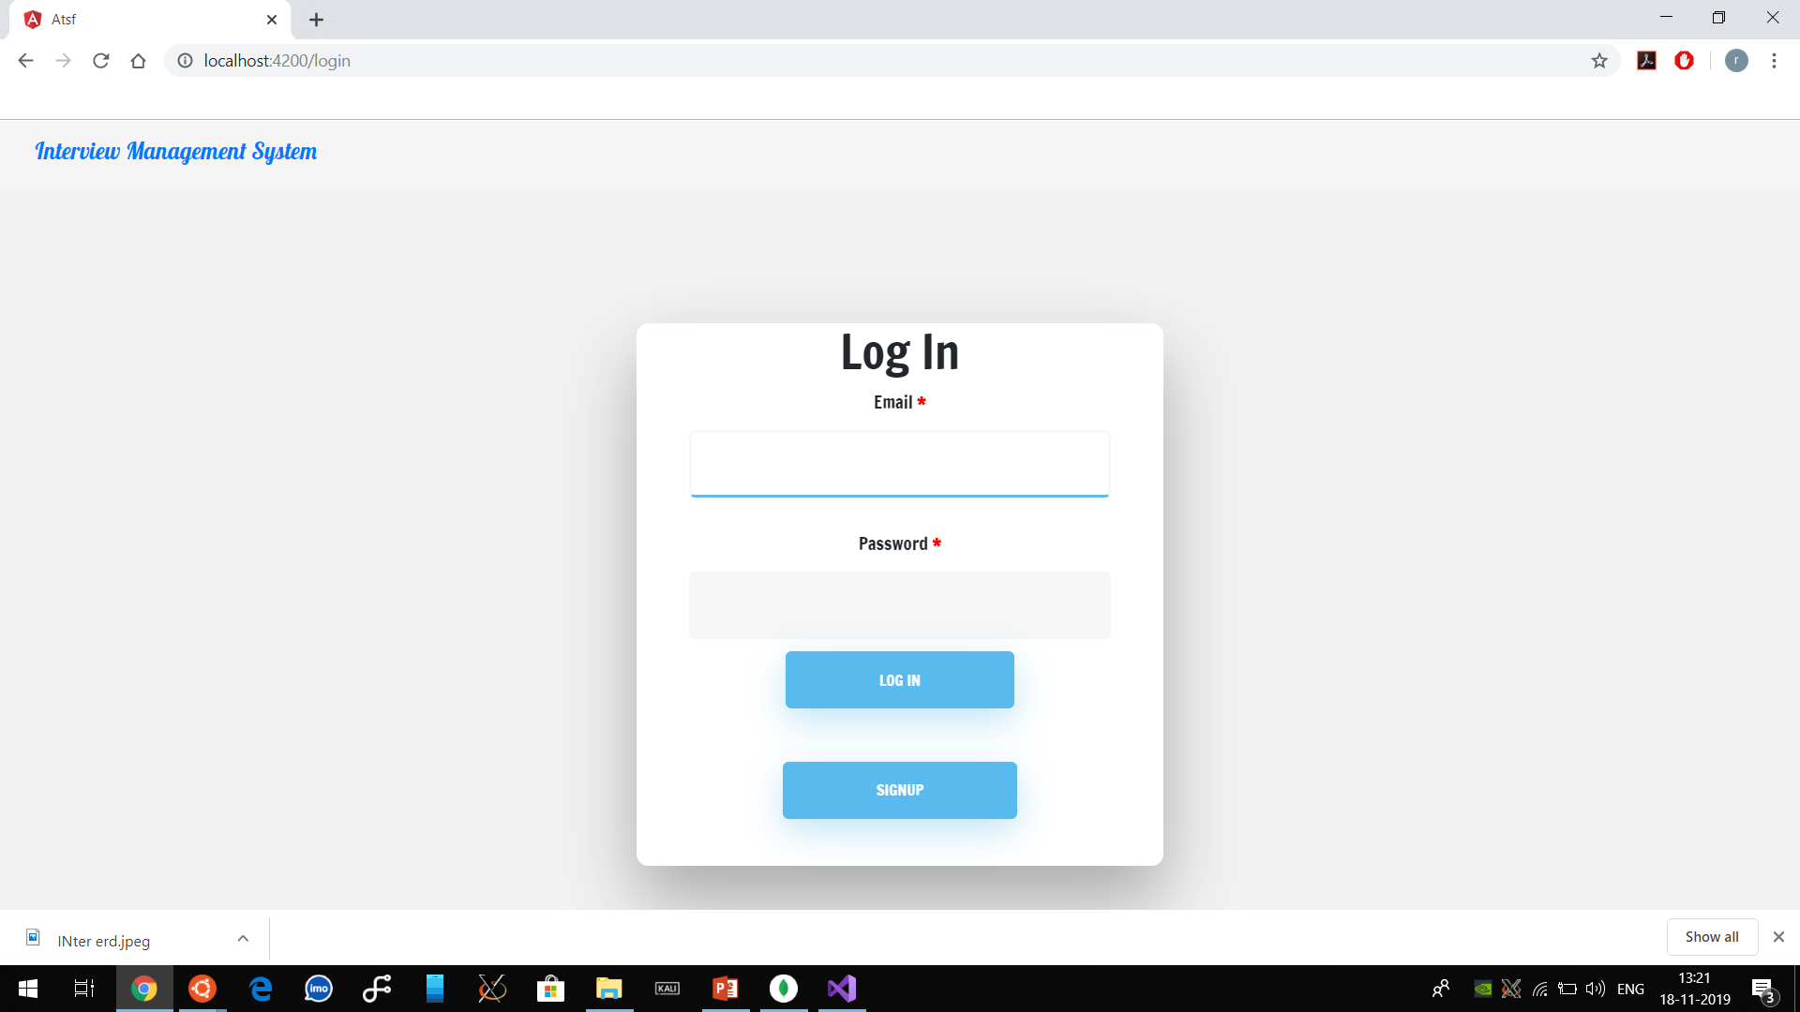

Slide 8
Admin End

Slide 9
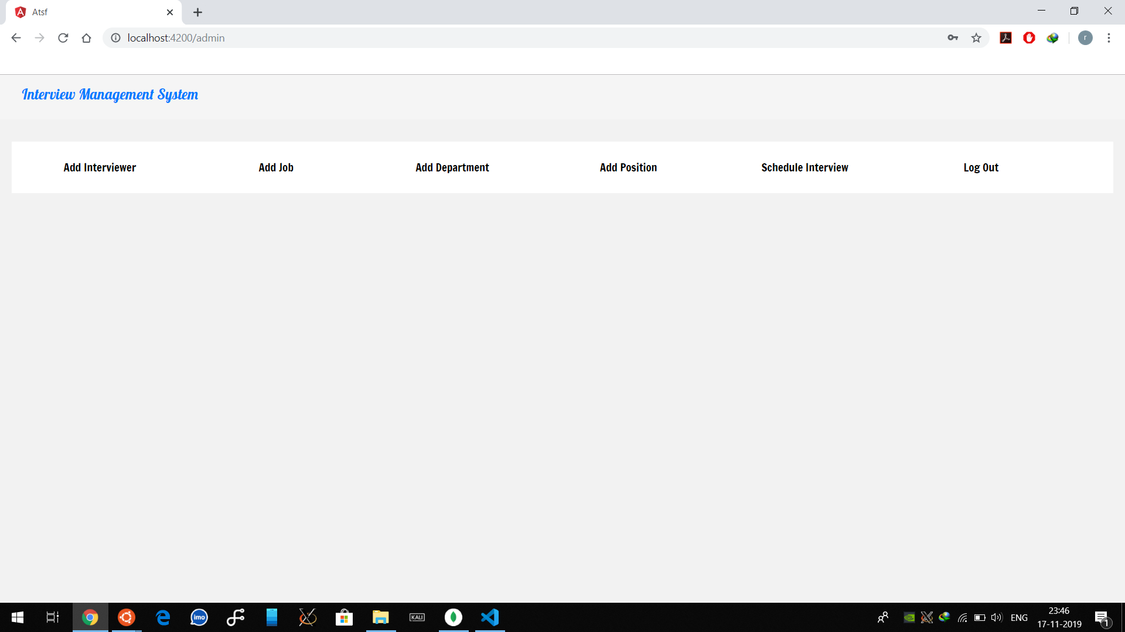

Slide 10
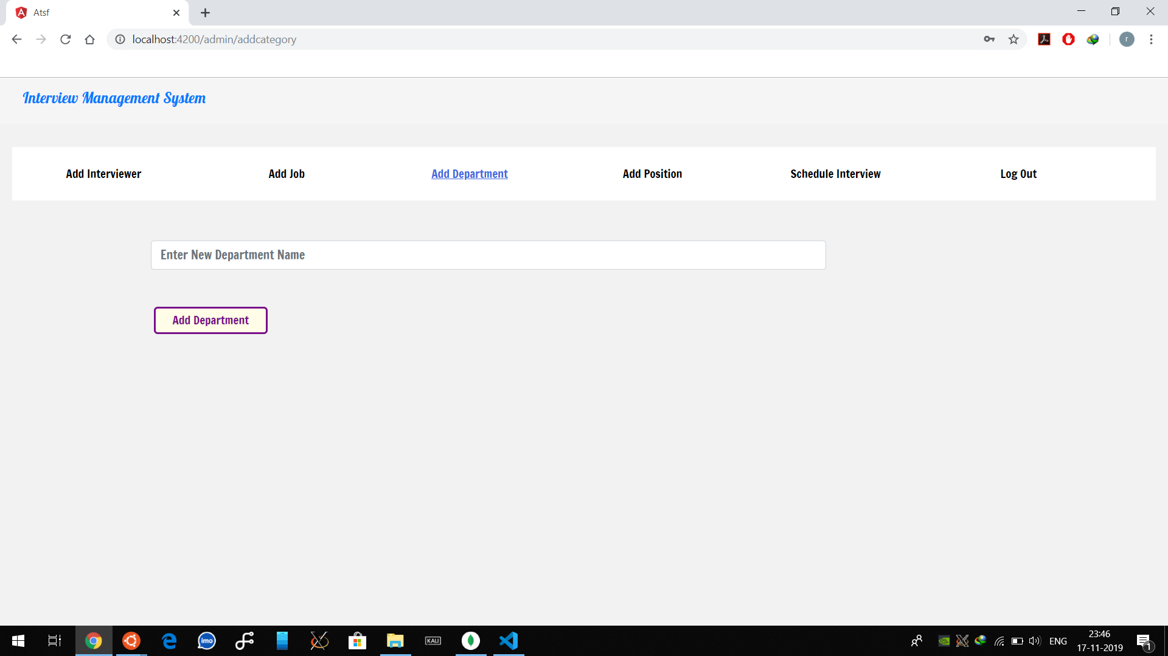
IN TWO OR THREE COLUMNS
Yellow
Is the color of gold, butter and ripe lemons. In the spectrum of visible light, yellow is found between green and orange.
Blue
Is the colour of the clear sky and the deep sea. It is located between violet and green on the optical spectrum.
Red
Is the color of blood, and because of this it has historically been associated with sacrifice, danger and courage.

Slide 11
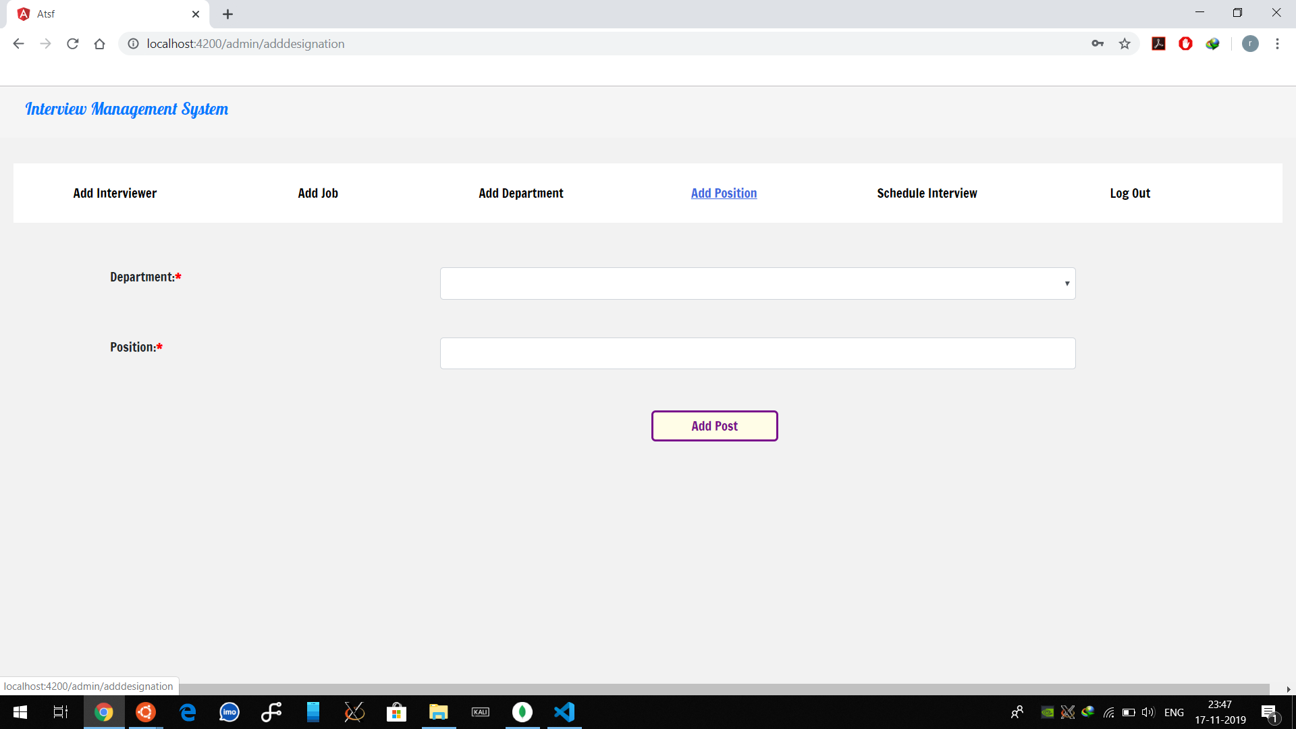
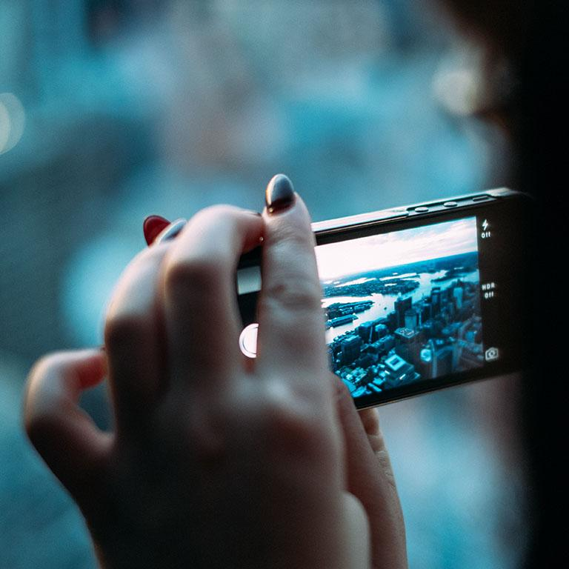
A PICTURE IS WORTH A THOUSAND WORDS
A complex idea can be conveyed with just a single still image, namely making it possible to absorb large amounts of data quickly.

Slide 12
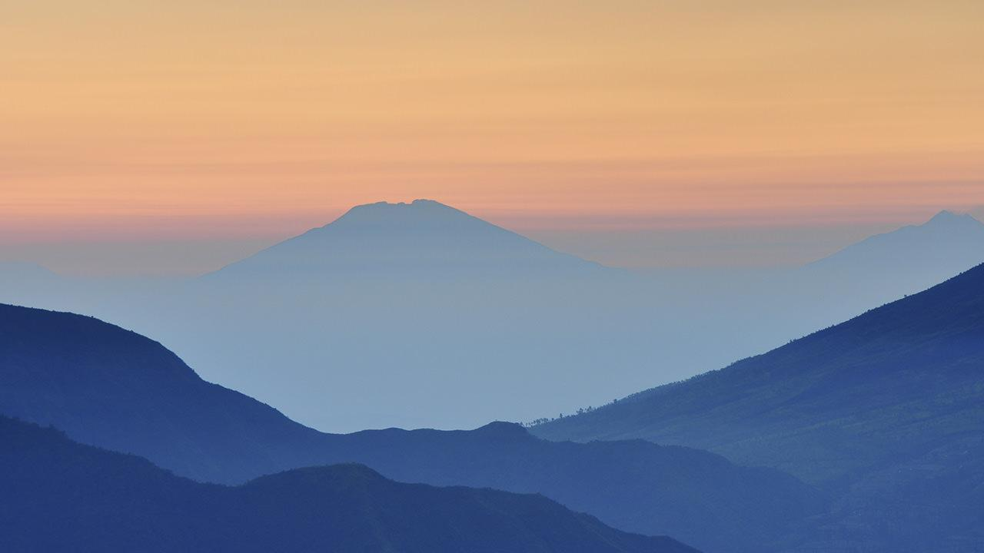
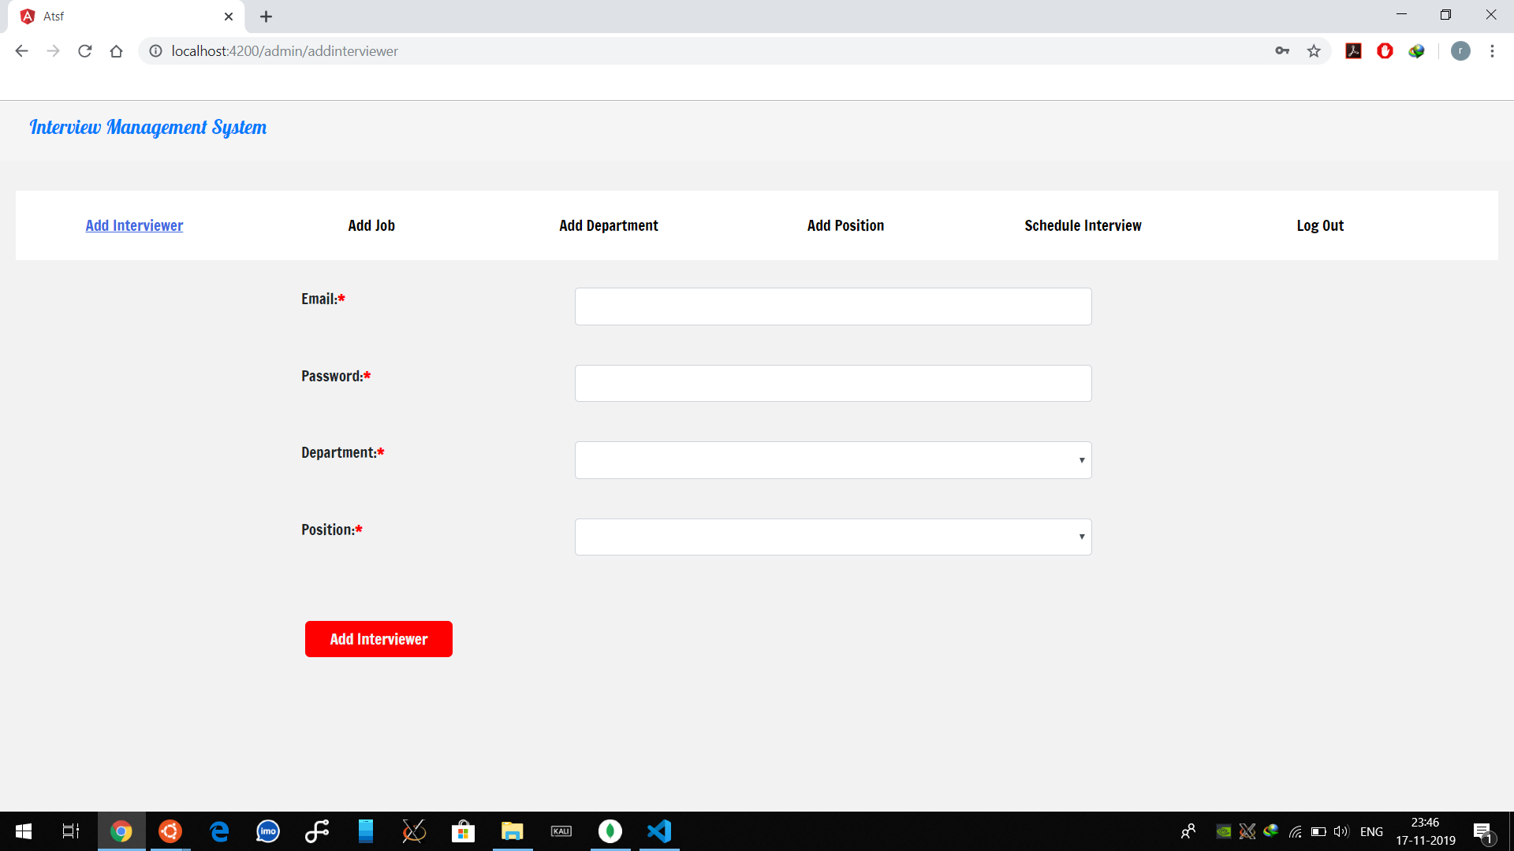
Want big impact?
USE BIG IMAGE.

Slide 13
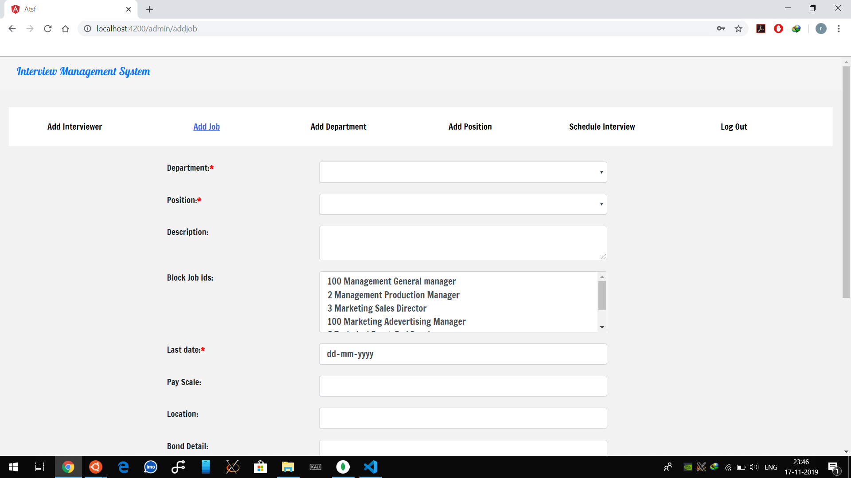
USE CHARTS TO EXPLAIN YOUR IDEAS
White
Gray
Black

Slide 14
Applicant End

Slide 15
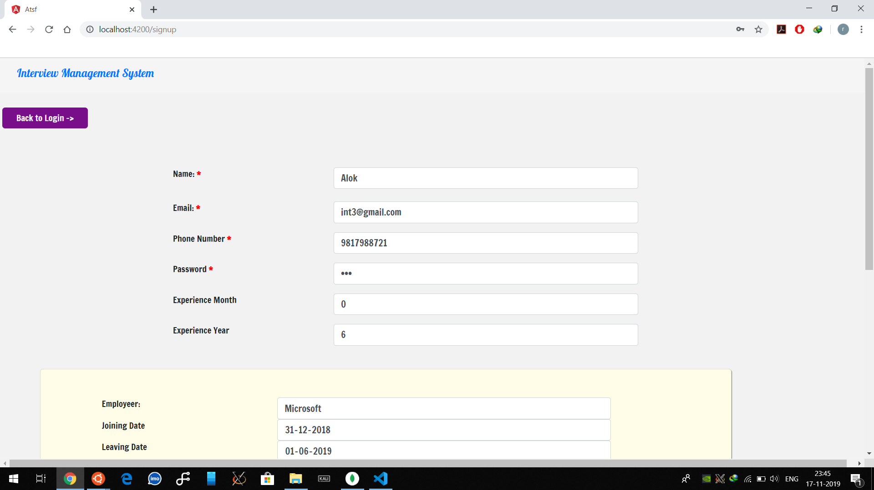
AND TABLES TO COMPARE DATA
 | A | B | C
Yellow | 10 | 20 | 7
Blue | 30 | 15 | 10
Orange | 5 | 24 | 16

Slide 16
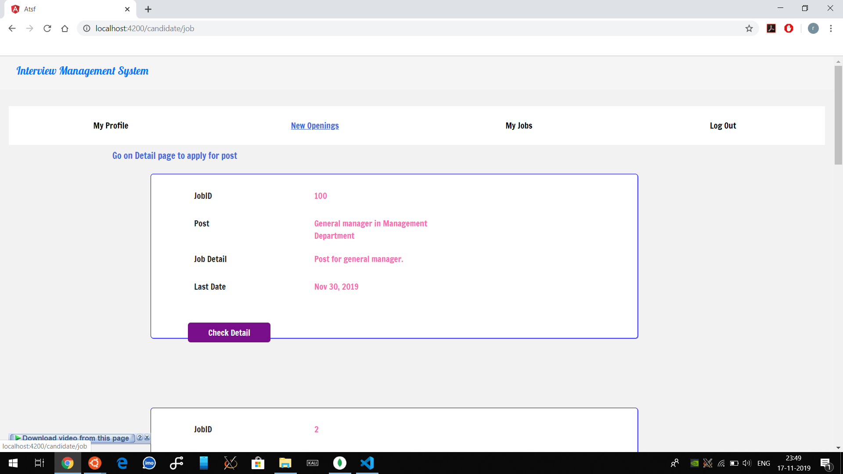
MAPS
our office

Slide 17
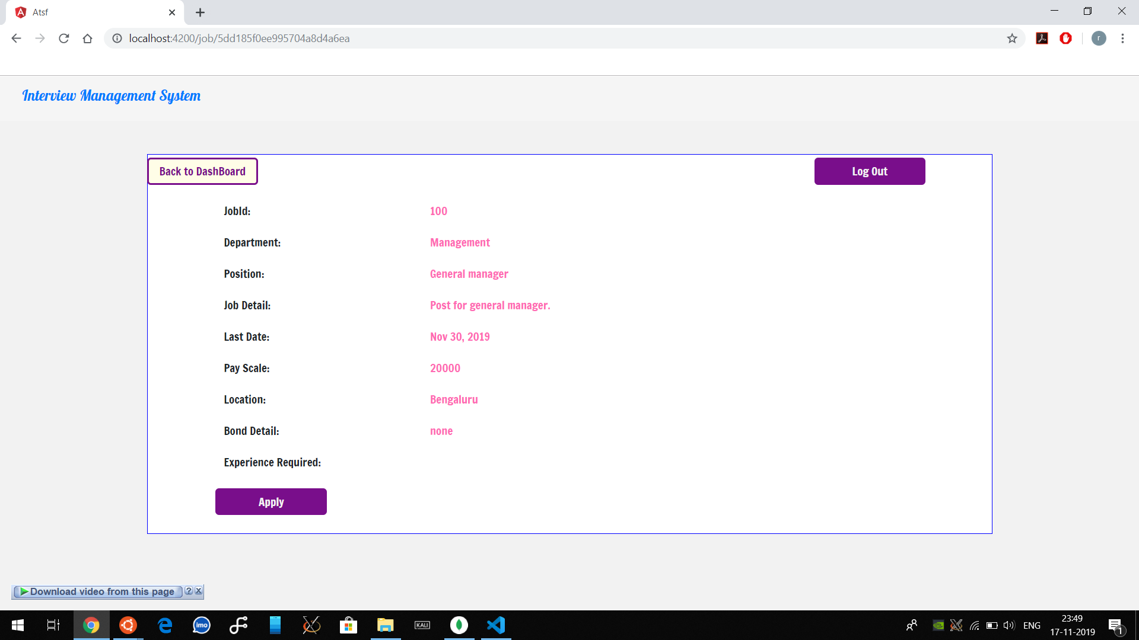
89,526,124
Whoa! That’s a big number, aren’t you proud?

Slide 18
Admin End

Slide 19
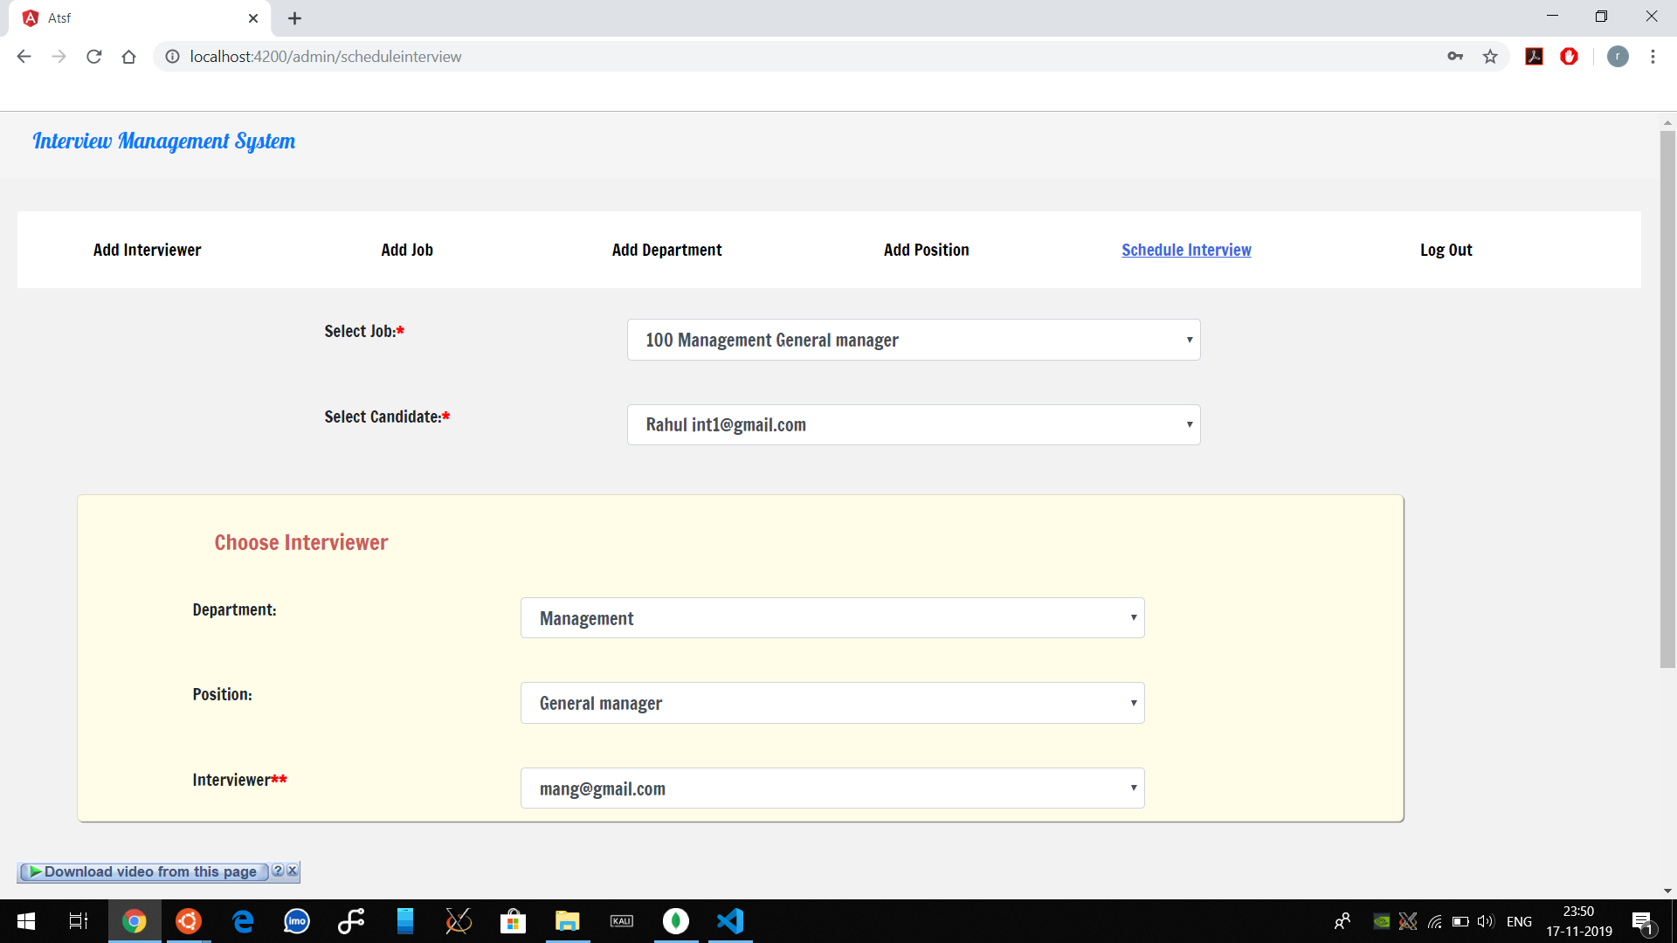
89,526,124$
185,244 users
100%
That’s a lot of money
And a lot of users
Total success!

Slide 20
Interviewer End

Slide 21
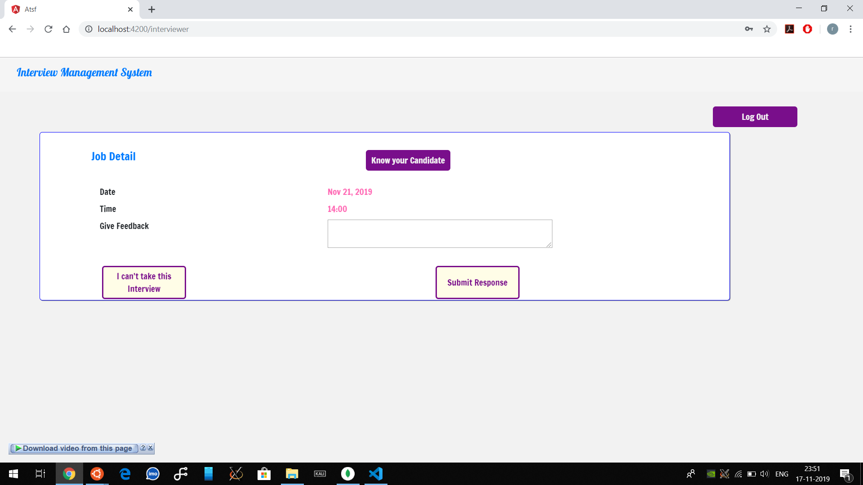
Let’s review some concepts
Yellow
Is the color of gold, butter and ripe lemons. In the spectrum of visible light, yellow is found between green and orange.
Blue
Is the colour of the clear sky and the deep sea. It is located between violet and green on the optical spectrum.
Red
Is the color of blood, and because of this it has historically been associated with sacrifice, danger and courage.
Yellow
Is the color of gold, butter and ripe lemons. In the spectrum of visible light, yellow is found between green and orange.
Blue
Is the colour of the clear sky and the deep sea. It is located between violet and green on the optical spectrum.
Red
Is the color of blood, and because of this it has historically been associated with sacrifice, danger and courage.

Slide 22
Admin End

Slide 23
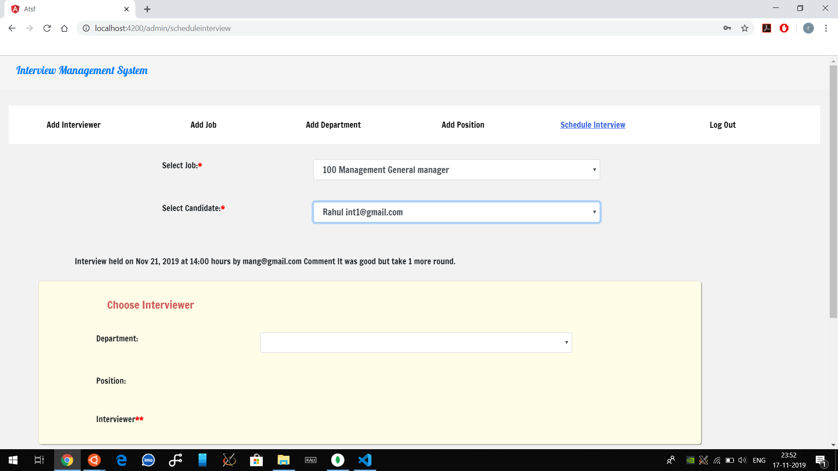
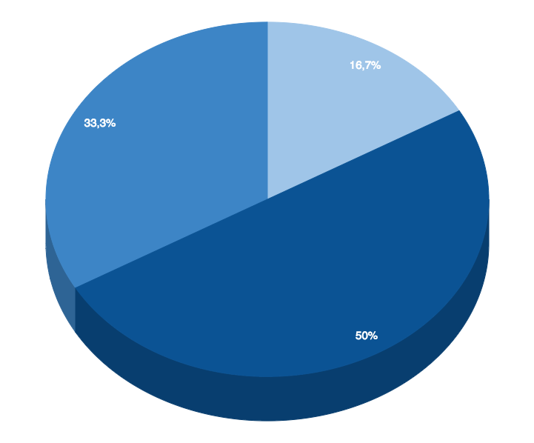
You can insert graphs from Google Sheets

Slide 24
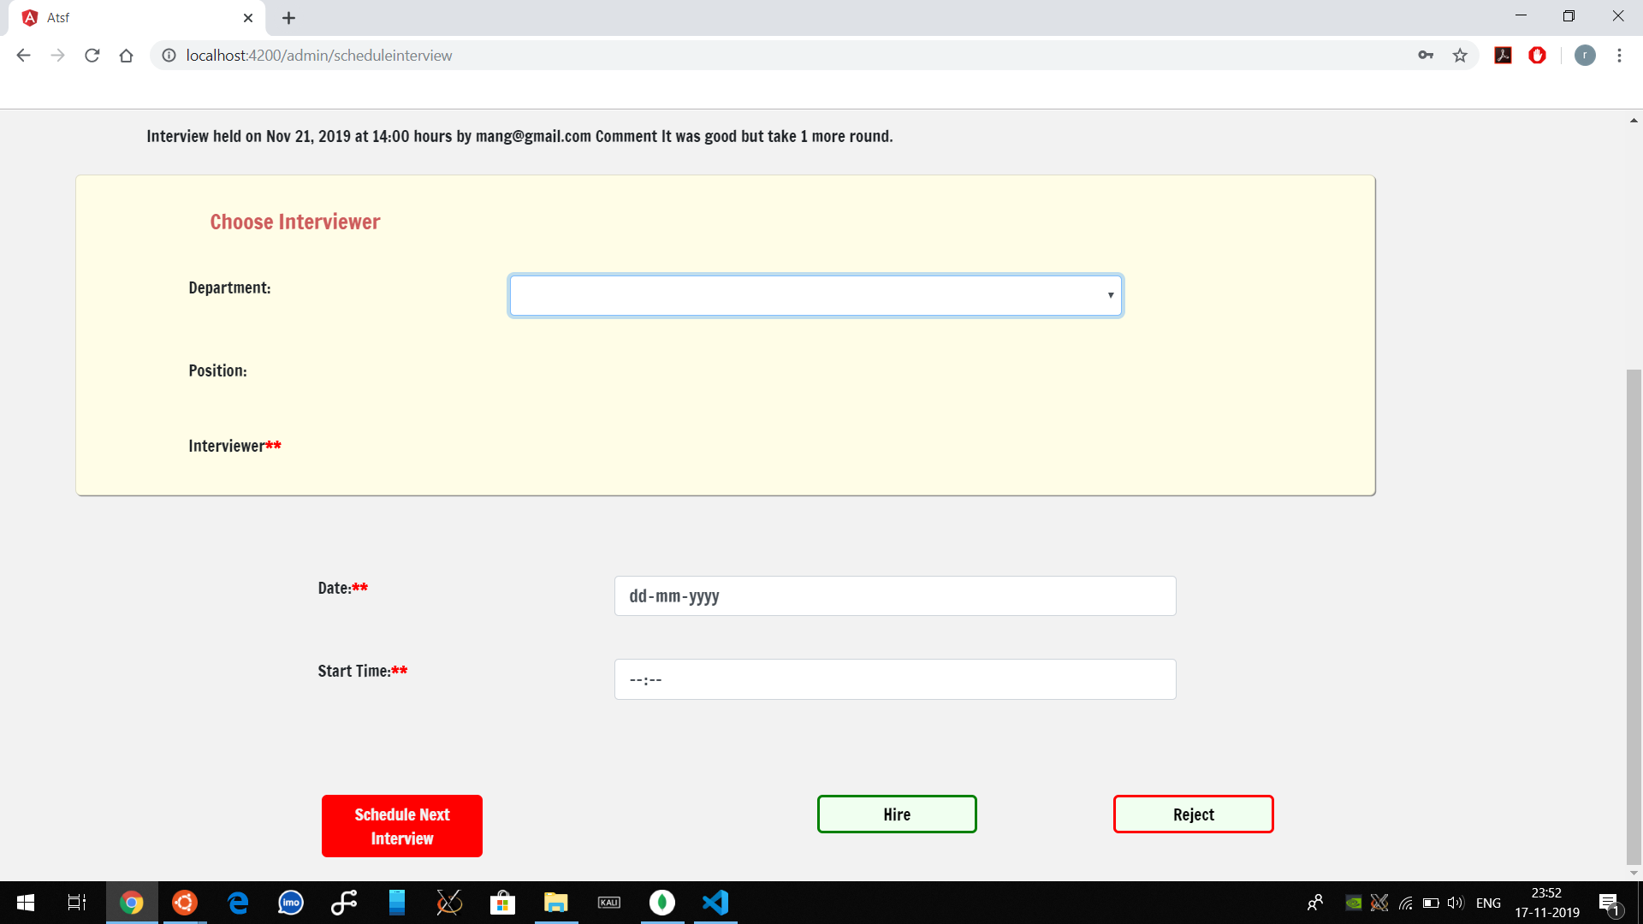
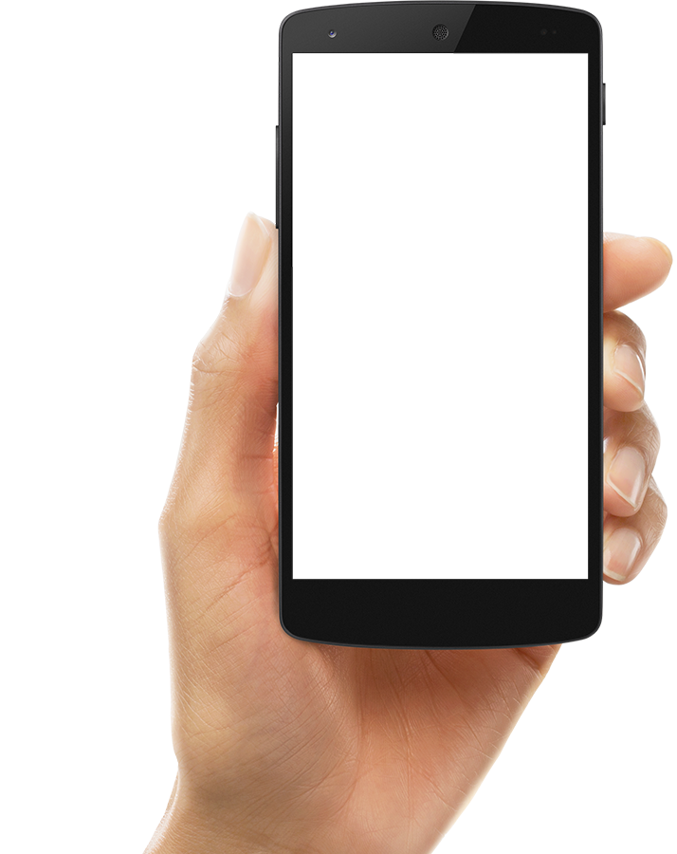
ANDROID PROJECT
Show and explain your web, app or software projects using these gadget templates.

Slide 25
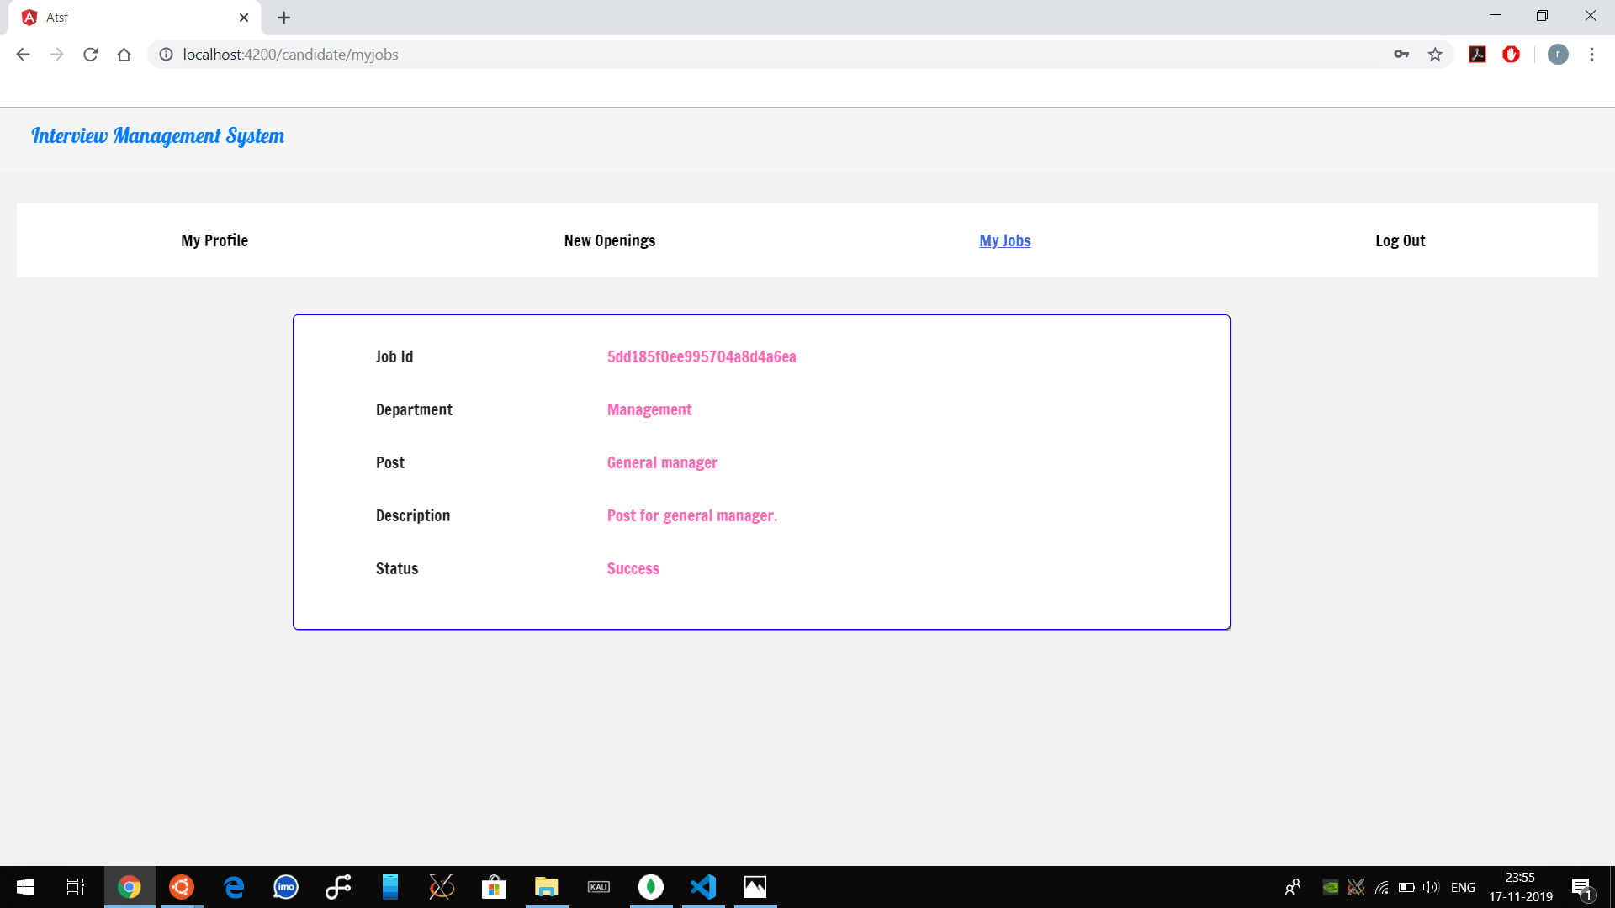
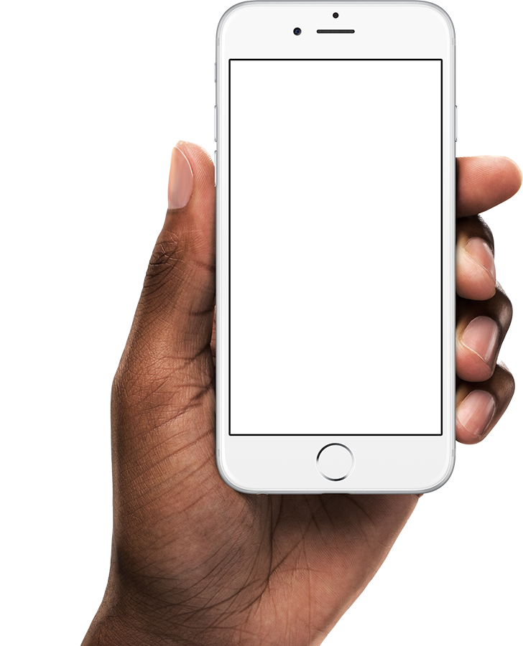
iPHONE PROJECT
Show and explain your web, app or software projects using these gadget templates.

Slide 26
Thank You

